Slide 1




GRADE 9-10 · AP PRECALCULUS · UNIT 1
Topic 1.10
Rational Functions
and Holes
Journey of 6 stations, 60 minutes
Polynomial and Rational Functions
Mr Malek Thiab
FAITH, RIGHTEOUSNESS AND WISDOM
Notes:
Speaker notes: Welcome to Topic 1.10: Rational Functions and Holes.
Timing: 60 minutes (Diagnose 6, Targeted Instruction 18, Practice 12, Production 12, Mastery Gate 6, Smart Production 6). For a 40-minute class scale every station by two thirds.
The journey map on the next slide shows the six stations; in slideshow mode the Morph transition zooms the station circles into the breadcrumb at the top of every later slide.

Slide 2


Today's journey
Six stations. Each one zooms in as we arrive.
Targeted Instruction
18 min
Production
12 min
Smart Production
6 min
2
4
6
1
3
5
Diagnose
6 min
Practice
12 min
Mastery Gate
6 min
FAITH, RIGHTEOUSNESS AND WISDOM
Notes:
Speaker notes: This is the whole map. Walk it left to right: Diagnose (what we already know), Targeted Instruction (Spot the common factor; Compare the multiplicities; Find the hole with a limit), Practice (Practice, Apply, Investigate), Production (climb rate of a survey drone), Mastery Gate (three questions to pass), Smart Production (create, then Time to Check).
In slideshow mode the Morph transition animates these circles shrinking into the breadcrumb on later slides; without Morph the slides fade.
Ask the class which station they think will be hardest.

Slide 3
What we are learning
OBJECTIVES
VOCABULARY
Determine holes in graphs of rational functions.
rational function
hole
real zero
multiplicity
numerator
denominator
output values
limit
vertical asymptote
STANDARDS
LO 1.10.A Determine holes in graphs of rational functions.
LO 1.10.A
FAITH, RIGHTEOUSNESS AND WISDOM
Mr Malek Thiab · 3
Notes:
Speaker notes: Read the objectives aloud one at a time and have students say which one they feel least sure about.
Vocabulary used today: rational function, hole, real zero, multiplicity, numerator, denominator, output values, limit, vertical asymptote.
Standards are listed on this slide.
The essential question and mathematical practices are not shown because they are not in the project documents; add them from the curriculum map if you want them displayed.

Slide 4

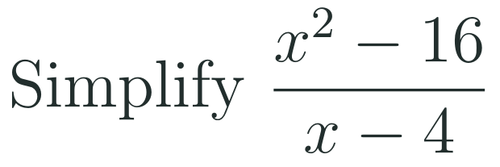
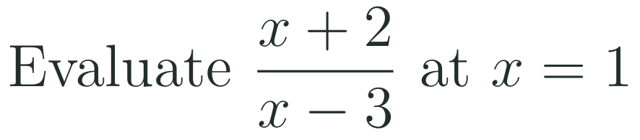
1
2
3
4
5
6
STATION 1 · DIAGNOSE · 6 MIN
Start here: three quick checks
1
2
3
Done when
All three answers are written without a calculator, and you can say which factor you divided out in Q2.
LO 1.10.A
FAITH, RIGHTEOUSNESS AND WISDOM
Mr Malek Thiab · 4
Notes:
Speaker notes (Diagnose, 6 min, no calculator):
Speaker notes (Diagnose, 6 min, no calculator).
Solutions: Q1 x^2 - 5x + 6 = (x - 2)(x - 3), because -2 and -3 multiply to 6 and add to -5. Q2 (x - 4)(x + 4)/(x - 4) = x + 4 for x not equal to 4. Q3 (1 + 2)/(1 - 3) = 3/(-2) = -3/2.
Verbal misconceptions: 'the pair only needs the right product' (check the sum); 'cancel the x^2 and the 16'; 'a negative denominator makes the fraction undefined'.
Adaptive routing: if more than 30% miss Q1 or Q2, route to slide 5 (spot the common factor). If more than 30% miss Q3, route to slide 7 (the limit gives the y-value).

Slide 5

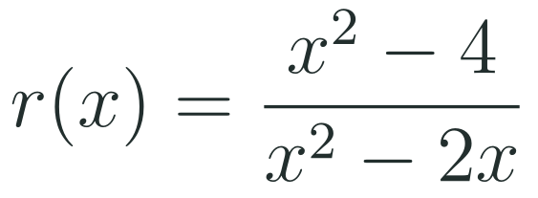
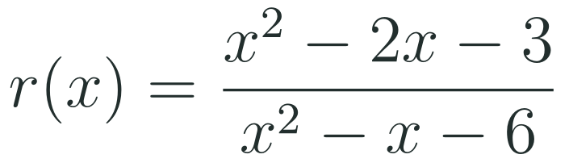
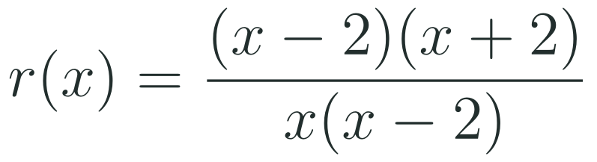
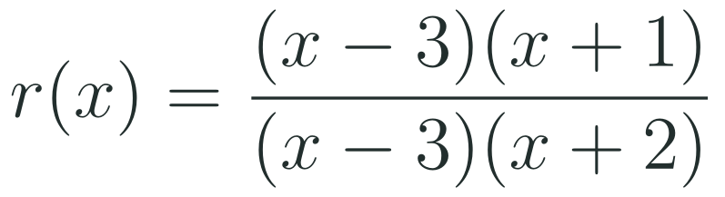

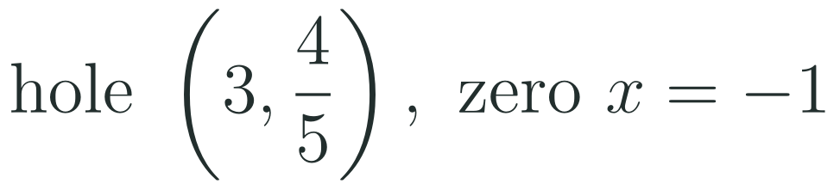
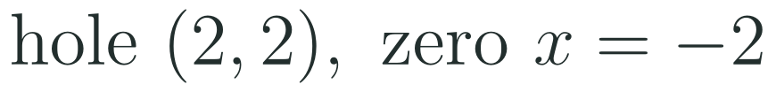
1
2
3
4
5
6
STATION 2 · TARGETED INSTRUCTION · 18 MIN
Spot the common factor
EXAMPLE A
EXAMPLE B
LO 1.10.A
FAITH, RIGHTEOUSNESS AND WISDOM
Mr Malek Thiab · 5
Notes:
Speaker notes (Targeted Instruction, block 1 of 3):
Speaker notes (Targeted Instruction, block 1 of 3, LO 1.10.A). LO 1.10.A: 'Determine holes in graphs of rational functions.' Suggested skills focus 3.C: 'Support conclusions or choices with a logical rationale or appropriate data.'
Worked solutions: Example A: x^2 - 4 = (x - 2)(x + 2) and x^2 - 2x = x(x - 2). The factor x - 2 is in both, so there is a hole at x = 2; the reduced function (x + 2)/x has value 4/2 = 2 there, so the hole is (2, 2). The factor x stays in the denominator: vertical asymptote x = 0. The zero is x = -2. Example B: x^2 - 2x - 3 = (x - 3)(x + 1) and x^2 - x - 6 = (x - 3)(x + 2). Hole at x = 3; reduced value (3 + 1)/(3 + 2) = 4/5, so the hole is (3, 4/5). The factor x + 2 remains: vertical asymptote x = -2. The zero is x = -1.
Verbal misconceptions: 'every zero of the denominator is a vertical asymptote'; 'a factor that cancels leaves no trace on the graph'; 'the hole is on the x-axis because the numerator is zero there' (the numerator of the reduced function is what matters).
Adaptive routing: if more than 30% miss Gate Q1, return to this slide and redo Example A aloud.

Slide 6
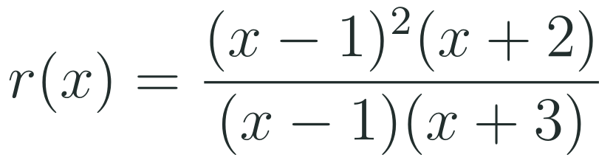
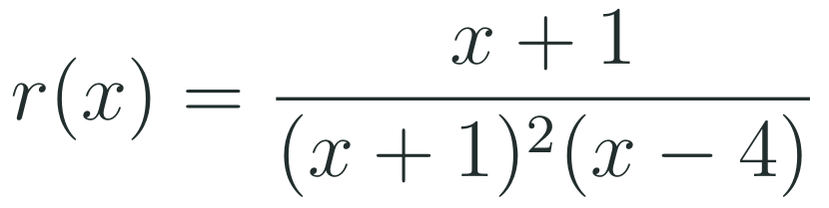


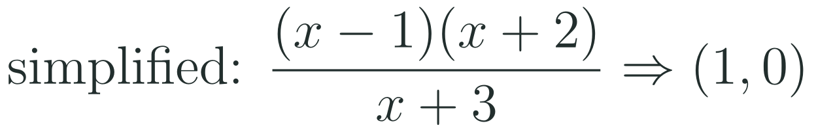
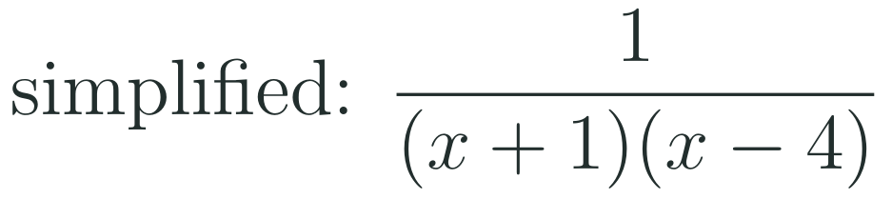
1
2
3
4
5
6
STATION 2 · TARGETED INSTRUCTION · 18 MIN
Compare the multiplicities
EXAMPLE A
EXAMPLE B
LO 1.10.A
FAITH, RIGHTEOUSNESS AND WISDOM
Mr Malek Thiab · 6
Notes:
Speaker notes (Targeted Instruction, block 2 of 3):
Speaker notes (Targeted Instruction, block 2 of 3, LO 1.10.A). EK 1.10.A.1: 'If the multiplicity of a real zero in the numerator is greater than or equal to its multiplicity in the denominator, then the graph of the rational function has a hole at the corresponding input value.' The second rule on the slide (less than gives a vertical asymptote) is the contrast case, not a quotation from the CED.
Worked solutions: Example A: at x = 1 the numerator has multiplicity 2 and the denominator multiplicity 1; 2 >= 1, so there is a hole at x = 1. After cancelling one factor, (x - 1)(x + 2)/(x + 3) is still zero at x = 1, so the hole is the point (1, 0). The factor x + 3 gives the vertical asymptote x = -3, and the remaining zero is x = -2. Example B: at x = -1 the numerator has multiplicity 1 and the denominator multiplicity 2; 1 < 2, so no hole. After cancelling, 1/((x + 1)(x - 4)) is undefined at x = -1: vertical asymptote x = -1. The factor x - 4 gives a second asymptote x = 4.
Verbal misconceptions: 'a hole always has y-value not zero'; 'cancelling the factor once always removes the zero or the asymptote completely'; 'the factor in the numerator cancels so there is a hole' (compare the powers first).
Adaptive routing: if more than 30% miss Gate Q2, return to this slide and redo Example B with the multiplicity count written under each factor.

Slide 7

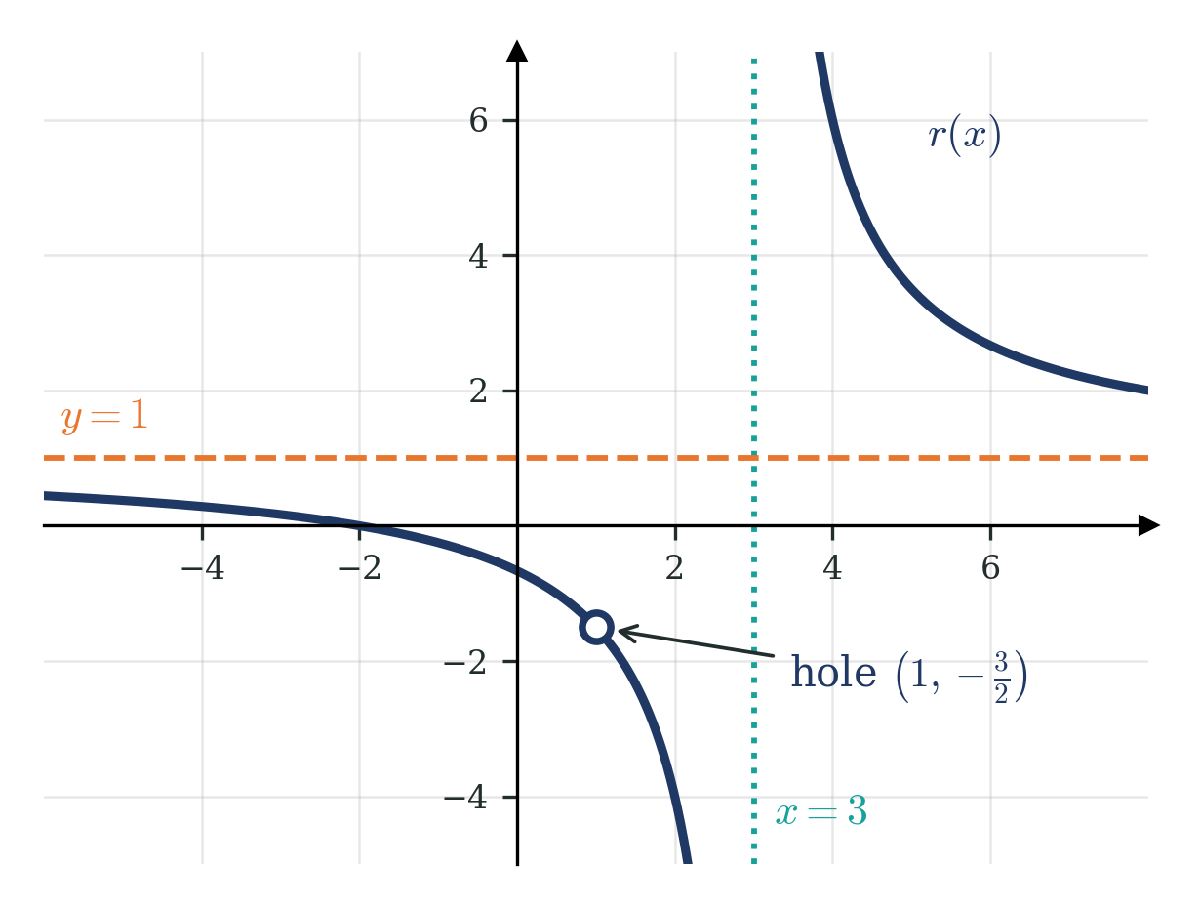
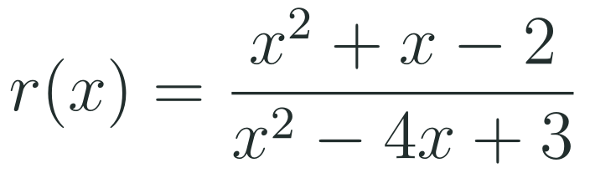
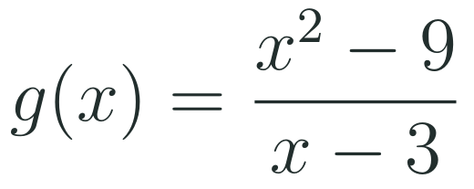
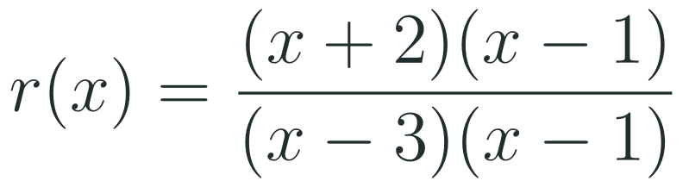
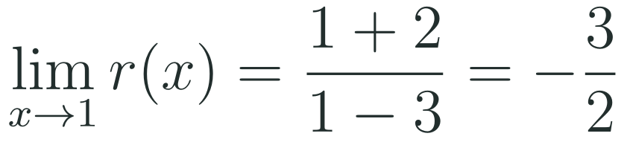
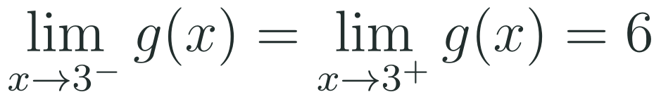
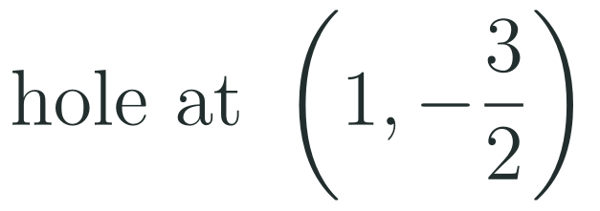
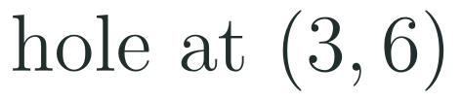
1
2
3
4
5
6
STATION 2 · TARGETED INSTRUCTION · 18 MIN
Find the hole with a limit
EXAMPLE A
EXAMPLE B
LO 1.10.A
FAITH, RIGHTEOUSNESS AND WISDOM
Mr Malek Thiab · 7
Notes:
Speaker notes (Targeted Instruction, block 3 of 3):
Speaker notes (Targeted Instruction, block 3 of 3, LO 1.10.A). EK 1.10.A.2: 'If the graph of a rational function r has a hole at x = c, then the location of the hole can be determined by examining the output values corresponding to input values sufficiently close to c. If input values sufficiently close to c correspond to output values arbitrarily close to L, then the hole is located at the point with coordinates (c, L). The corresponding mathematical notation is lim as x approaches c of r(x) = L. It should be noted that the limit from the left, the limit from the right and the limit as x approaches c are all equal to L.' (The fetched CED text had garbled symbols in this statement, such as 'x c =' for x = c; the wording above is reconstructed, so check it against the CED PDF.)
Worked solutions: Example A: x^2 + x - 2 = (x + 2)(x - 1) and x^2 - 4x + 3 = (x - 3)(x - 1). The common factor x - 1 gives a hole at x = 1. The reduced function is (x + 2)/(x - 3), so the limit as x approaches 1 is (1 + 2)/(1 - 3) = -3/2: the hole is (1, -3/2). The graph on the slide shows the open circle, the vertical asymptote x = 3, the horizontal asymptote y = 1 and the zero x = -2. Example B: g(2.99) = 2.99 + 3 = 5.99 and g(3.01) = 6.01; the outputs approach 6 from both sides, so the limit is 6 and the hole is (3, 6).
Verbal misconceptions: 'the limit does not exist because g(3) is undefined' (the limit only needs nearby outputs); 'the hole is at the y-value of the horizontal asymptote'; 'only the left side needs to approach L'.
Adaptive routing: if more than 30% miss Gate Q3, return to this slide and redo Example B with a table of five inputs on each side of 3.

Slide 8
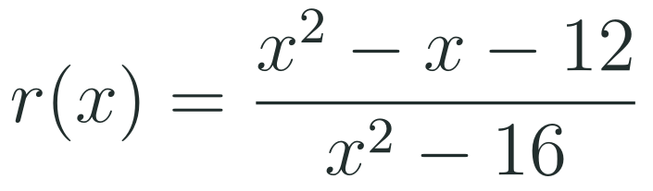
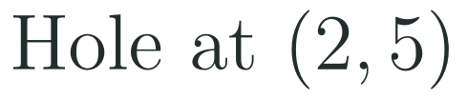
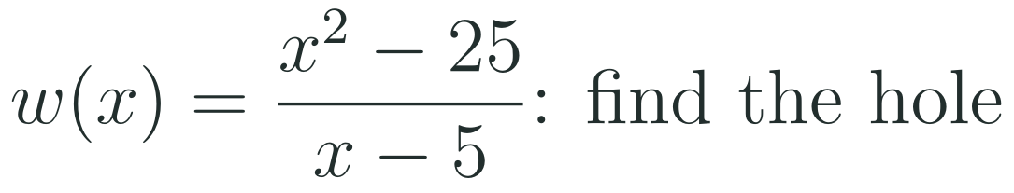
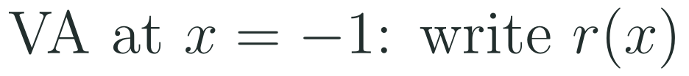
1
2
3
4
5
6
STATION 3 · PRACTICE · 12 MIN
Give it a go: Practice, Apply, Investigate
PRACTICE
APPLY
INVESTIGATE
Secure the method
Use it in context
Find out why
Done when: you factor both parts, give the coordinates of the hole and write the vertical asymptote.
Done when: you give the hole as a point and say why the context never reaches it (the length must be positive).
Done when: your function is in factored form and you check that its limit at the hole's input is 5.
LO 1.10.A
FAITH, RIGHTEOUSNESS AND WISDOM
Mr Malek Thiab · 8
Notes:
Speaker notes (Practice, 12 min; tierless differentiation: students choose the starting column and may move across):
Speaker notes (Practice, 12 min; tierless: students choose the starting column and may move across).
Answers: Practice: x^2 - x - 12 = (x - 4)(x + 3) and x^2 - 16 = (x - 4)(x + 4). Hole at x = 4 with value (4 + 3)/(4 + 4) = 7/8, so the hole is (4, 7/8); vertical asymptote x = -4. Apply: w(x) = (x - 5)(x + 5)/(x - 5) = x + 5, hole at (5, 10); the length x - 5 must be positive, so x > 5 and the hole is outside the domain of the context. Investigate: one answer is r(x) = 15(x - 2)/((x - 2)(x + 1)); the limit at 2 is 15/3 = 5 and x = -1 stays in the denominator. Other answers work too: any numerator (x - 2)k(x) with k(2) = 15 and k(-1) not zero.
Verbal misconceptions: 'the hole is at the y-value 0'; 'a hole only exists if the context allows the input'.
Adaptive routing: finished students move to Apply then Investigate; stuck students return to slide 5.

Slide 9
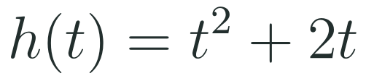
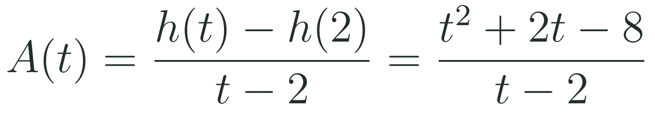
1
2
3
4
5
6
STATION 4 · PRODUCTION · 12 MIN
Production: climb rate of a survey drone
THE MODEL
DONE WHEN
A survey drone rises so that its height in metres is the function h below, where the input is the time in seconds. Its average climb rate between 2 seconds and a later time is the function A below, defined for positive times other than 2. The numbers are model values for practice, not real data.
The numerator is factored and the common factor named.
The table shows four values that approach the same number.
The limit is written with limit notation and equals the y-value of the hole.
The meaning is given in metres per second.
Factor the numerator, simplify the climb rate and state the coordinates of the hole.
Complete a table of the climb rate for the times 1.9, 1.99, 2.01 and 2.1 and write the limit with notation.
Say in one sentence what the limit means for the drone at 2 seconds.
Hint: the numerator factors into t minus 2 and t plus 4, so the simplified function is a line with one point missing.
LO 1.10.A
FAITH, RIGHTEOUSNESS AND WISDOM
Mr Malek Thiab · 9
Notes:
Speaker notes (Production, 12 min):
Speaker notes (Production, 12 min).
Solutions: h(2) = 4 + 4 = 8, so h(t) - h(2) = t^2 + 2t - 8 = (t - 2)(t + 4). A(t) = t + 4 for t not equal to 2: hole at (2, 6). Table: A(1.9) = 5.9, A(1.99) = 5.99, A(2.01) = 6.01, A(2.1) = 6.1. The outputs approach 6 from both sides: limit as t approaches 2 of A(t) = 6. Meaning: the drone is climbing at 6 metres per second at t = 2 seconds (the average rate over shorter and shorter intervals approaches 6), even though A(2) itself is undefined.
Verbal misconceptions: students say 'A(2) does not exist so the drone has no climb rate at 2 seconds'; students stop the table after one side.
Adaptive routing: if students cannot start, send them to slide 7 Example B and the hint.

Slide 10
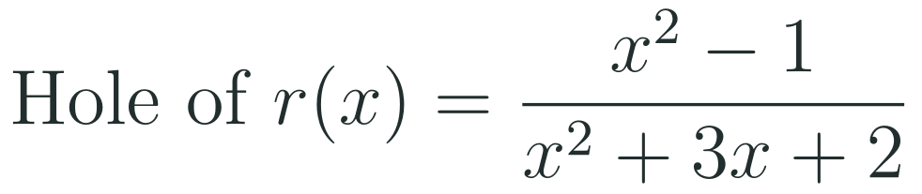
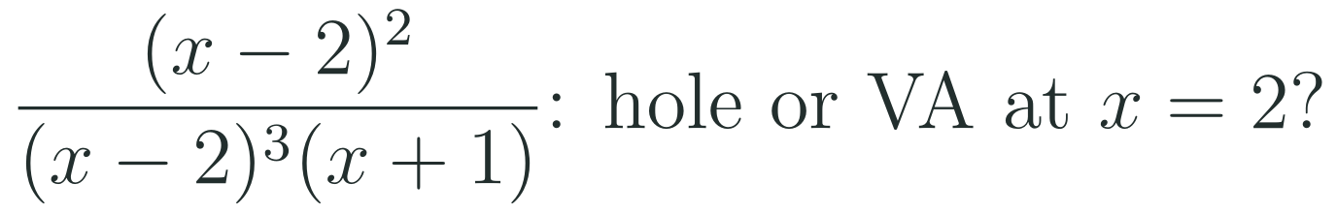
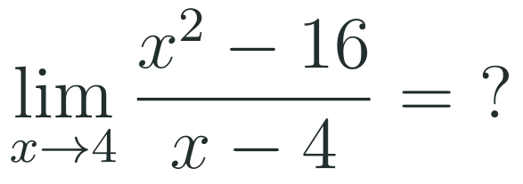
1
2
3
4
5
6
STATION 5 · MASTERY GATE · 6 MIN
Mastery Gate: three questions to pass
1
2
3
Pass mark
3 of 3 correct unlocks Station 6. Fewer than that: return to the slide for the question you missed, redo it, then re-take the gate.
LO 1.10.A
FAITH, RIGHTEOUSNESS AND WISDOM
Mr Malek Thiab · 10
Notes:
Speaker notes (Mastery Gate, 6 min, no calculator):
Speaker notes (Mastery Gate, 6 min, no calculator).
Answers: Q1 (x - 1)(x + 1)/((x + 1)(x + 2)): hole at x = -1, value (-1 - 1)/(-1 + 2) = -2, so the hole is (-1, -2); vertical asymptote x = -2. Q2 numerator multiplicity 2 < denominator multiplicity 3, so vertical asymptote at x = 2 (and another at x = -1), no hole. Q3 (x - 4)(x + 4)/(x - 4) = x + 4 near 4, so the limit is 8.
Verbal misconceptions: Q1 'hole at x = -2 because it is the other factor'; Q2 'the factor cancels so it is a hole'; Q3 'the limit does not exist because the denominator is zero'.
Adaptive routing: Q1 missed, route to slide 5 Example A; Q2 missed, route to slide 6 Example B; Q3 missed, route to slide 7 Example B.

Slide 11
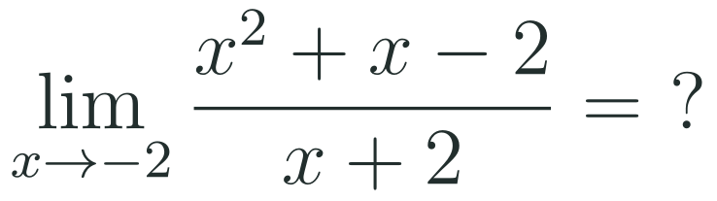
1
2
3
4
5
6
STATION 6 · SMART PRODUCTION · 6 MIN
Smart Production: make one, then check it
CREATE
TIME TO CHECK
Write a rational function in factored form with a hole where x is 3 and a zero where x is negative 1.
Expand it on the back and find the y-value of the hole.
Swap with a partner: they use a limit to confirm the hole.
Exit ticket: write your answer on a sticky note and place it on the door.
Done when: your partner confirms the hole, the zero and the y-value using a limit.
Next lesson: Topic 1.11 Equivalent Representations of Polynomial and Rational Expressions.
LO 1.10.A
FAITH, RIGHTEOUSNESS AND WISDOM
Mr Malek Thiab · 11
Notes:
Speaker notes (Smart Production, 6 min):
Speaker notes (Smart Production, 6 min).
Create example: (x - 3)(x + 1)/(x - 3) has a hole at x = 3 with value 3 + 1 = 4, so the hole is (3, 4) and the zero is x = -1. Exit answer: x^2 + x - 2 = (x + 2)(x - 1), so the quotient is x - 1 and the limit is -2 - 1 = -3.
Verbal misconceptions: students keep the cancelled factor in the zero list; ask: is x = 3 an input of the function?

Slide 12
Journey complete
Targeted Instruction
Production
Smart Production
✓
✓
✓
✓
✓
✓
Diagnose
Practice
Mastery Gate
A shared factor with numerator multiplicity at least the denominator multiplicity gives a hole, and the limit of the reduced function at that input is the y-value of the hole.
FAITH, RIGHTEOUSNESS AND WISDOM
Notes:
Speaker notes: Every station is checked off. Recap in one sentence: A shared factor with numerator multiplicity at least the denominator multiplicity gives a hole, and the limit of the reduced function at that input is the y-value of the hole. Collect the Time to Check responses. Next lesson: Topic 1.11 Equivalent Representations of Polynomial and Rational Expressions.

